Slide 1
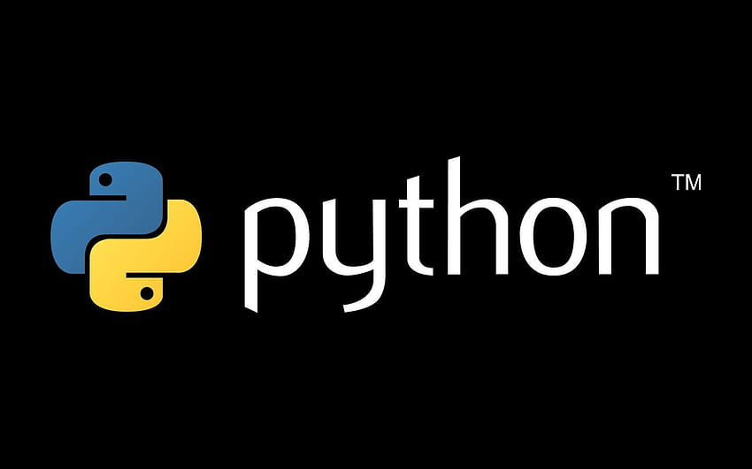
Python internship
{
}
...
By: Kshamitha N

Slide 2
01
02
03
3
Data manipulation in python
Methods in python
Functions in python
Table of contents
2
1

Slide 3
01
02
3
Data manipulation in python
Functions in python
Methods in python
2
1

Slide 4
01
03
3
Data manipulation in python
Functions in python
Modules in python
2
1

Slide 5
01
02
03
3
Data manipulation in python
Methods in python
Functions in python
2
1

Slide 6
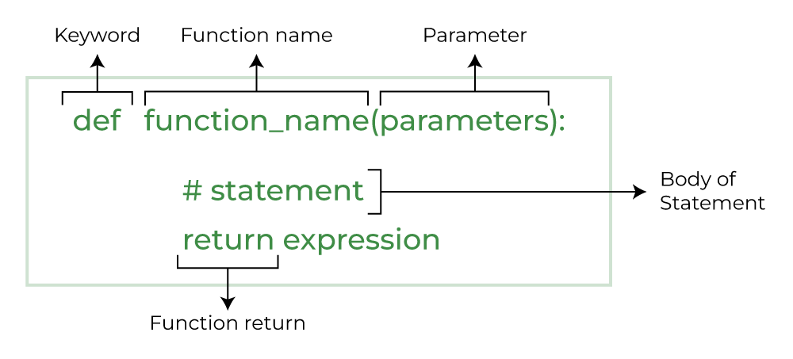
01
Functions in python
Python Functions is a block of statements that return the specific task. The idea is to put some commonly or repeatedly done tasks together and make a function so that instead of writing the same code again and again for different inputs, we can do the function calls to reuse code contained in it over and over again.
Some Benefits of Using Functions
Increase Code Readability
Increase Code Reusability
Syntax of function declaration

Slide 7
Functions in python
Types of Functions in Python
Built-in library function: These are Standard functions in Python that are available to use.
User-defined function: We can create our own functions based on our requirements.
Some of the built-in functions are:
Function | Description
Abs() | Returns the absolute value of a number
All() | Returns True if all items in an iterable object are true
Any() | Returns True if any item in an iterable object is true
Ascii() | Returns a readable version of an object. Replaces none-ascii characters with escape character
Bin() | Returns the binary version of a number
Bool() | Returns the boolean value of the specified object
Bytearray() | Returns an array of bytes
Bytes() | Returns a bytes object
callable() | Returns True if the specified object is callable, otherwise False
chr() | Returns a character from the specified Unicode code.
classmethod() | Converts a method into a class method
compile() | Returns the specified source as an object, ready to be executed
complex() | Returns a complex number

Slide 8
Functions in python
Creating a Function in Python
We can create a user-defined function in Python, using the def keyword. We can add any type of functionalities and properties to it as we require
Example:
def fun():
print("Hello world")
Calling a Python Function
After creating a function in Python we can call it by using the name of the function followed by parenthesis containing parameters of that particular function.
Example:
def fun():
print("Welcome to Python")
fun()

Slide 9
Functions in python
Python Function with Parameters
Defining and calling a function with parameters:
def function_name(parameter: data_type) -> return_type:
"""Docstring"""
# body of the function
return expression
Example:
def add(num1: int, num2: int) -> int:
"""Add two numbers"""
num3 = num1 + num2
return num3
# Driver code
num1, num2 = 5, 15
ans = add(num1, num2)
print(f"The addition of {num1} and {num2} results {ans}.")

Slide 10
Functions in python
Python Function Arguments:
Arguments are the values passed inside the parenthesis of the function. A function can have any number of arguments separated by a comma.
In this example, we will create a simple function in Python to check whether the number passed as an argument to the function is even or odd.
Example:
def evenOdd(x):
if (x % 2 == 0):
print("even")
else:
print("odd")
# Driver code to call the function
evenOdd(2)
evenOdd(3)
Output:
even
odd

Slide 11
Functions in python
Types of Python Function Arguments:
Python supports various types of arguments that can be passed at the time of the function call. In Python, we have the following 4 types of function arguments.
Default argument
Keyword arguments (named arguments)
1)Default argument
A default argument is a parameter that assumes a default value if a value is not provided in the function call for that argument. The following example illustrates Default arguments.
def myFun(x, y=50):
print("x: ", x)
print("y: ", y)
myFun(10)

Slide 12
Functions in python
2)Keyword Arguments
The idea is to allow the caller to specify the argument name with values so that the caller does not need to remember the order of parameters.
Example:
# Python program to demonstrate Keyword Arguments
def student(firstname, lastname):
print(firstname, lastname)
# Keyword arguments
student(firstname=‘python', lastname='Practice')
student(lastname='Practice', firstname=‘python')
Output:
python Practice
python Practice

Slide 13
Functions in python
Python Function within Functions:
A function that is defined inside another function is known as the inner function or nested function. Nested functions are able to access variables of the enclosing scope. Inner functions are used so that they can be protected from everything happening outside the function.
Example:
# Python program to
# demonstrate accessing of
# variables of nested functions
def f1():
s = 'I love python'
def f2():
print(s)
f2()
# Driver's code
f1()
Output:
I love python

Slide 14
Modules in python
02
In Python, modules are files that contain Python code and are used to organize code into reusable and maintainable units. Modules can define functions, classes, and variables, and they can be imported into other Python scripts or modules to reuse their code. Here's a breakdown of how modules work in Python:
Creating a Module: To create a module, you typically create a Python script (a .py file) and define functions, classes, or variables within it. For example, you can create a module named my_module.py with the following content:
Example:
# my_module.py
def greet(name):
return f"Hello, {name}!"
PI = 3.14159

Slide 15
Modules in python
Importing a Module: You can import a module using the import statement in another Python script or interactive session:
Example:
import my_module
result = my_module.greet("Alice")
print(result) # Output: "Hello, Alice!"
print(my_module.PI) # Output: 3.14159

Slide 16
Modules in python
Built-in Modules: Python also comes with a rich standard library containing various built-in modules that provide additional functionality. These modules cover a wide range of tasks, from working with files (os, io) to mathematical operations (math, random) and more.
Example:
import os
current_directory = os.getcwd()
print(current_directory)

Slide 17
Data manipulaion in python
03
Data Manipulation in Python
Data manipulation in Python involves working with data to perform various tasks such as cleaning, transforming, aggregating, and analyzing it. Python provides several libraries and tools that make data manipulation efficient and convenient. Here are some common libraries and techniques for data manipulation in Python:
1. NumPy: NumPy is a fundamental library for numerical operations in Python. It provides support for arrays and matrices, which are essential for data manipulation tasks.
Example:
import numpy as np
# Create a NumPy array
data = np.array([1, 2, 3, 4, 5])
# Perform operations on the array
mean = np.mean(data)

Slide 18
Data manipulaion in python
Pandas: Pandas is a powerful library for data manipulation and analysis. It provides data structures like DataFrames and Series, which allow you to work with tabular data effectively.
Example:
import pandas as pd
# Create a DataFrame from a dictionary
data = pd.DataFrame({'A': [1, 2, 3], 'B': [4, 5, 6]})
# Select a column
column_A = data['A']
# Filter rows based on a condition
filtered_data = data[data['B'] > 4]
3. Matplotlib and Seaborn: These libraries are used for data visualization, which is often an important part of data manipulation to gain insights from data.
Example:
import matplotlib.pyplot as plt
import seaborn as sns
# Create a scatter plot
sns.scatterplot(x='A', y='B', data=data)
plt.show()

Slide 19
Data manipulaion in python
4. NumPy and Pandas for Data Cleaning: You can use these libraries to handle missing data, remove duplicates, and perform other data cleaning tasks.
Example:
# Handling missing values in Pandas
data.dropna() # Remove rows with missing values
data.fillna(value) # Fill missing values with a specific value
5. NumPy and Pandas for Data Transformation: You can manipulate data by performing operations like sorting, merging, and reshaping.
Example:
# Sorting data in Pandas
sorted_data = data.sort_values(by='A')
# Merging DataFrames in Pandas
merged_data = pd.concat([df1, df2], axis=1)
# Reshaping data in Pandas
pivoted_data = data.pivot(index='A', columns='B', values='C')

Slide 20
Data manipulaion in python
6. Aggregation: You can use functions like groupby in Pandas to group data and perform aggregation operations.
Example:
# Grouping and aggregating data in Pandas
grouped_data = data.groupby('Category')['Value'].sum()
7. List Comprehensions: For simple data manipulations, list comprehensions can be used to create new lists or transform existing ones.
Example:
# Using list comprehensions to transform data
squared_numbers = [x**2 for x in data]

Slide 21
Data manipulaion in python
8. Regular expressions: Python’s ‘re’ module allows you to work with text data and perform pattern-based data manipulation.
Example:
import re
# Extracting data using regular expressions
pattern = r'\d{3}-\d{2}-\d{4}'
matches = re.findall(pattern, text)

Slide 22
Thank you

